Slide 1
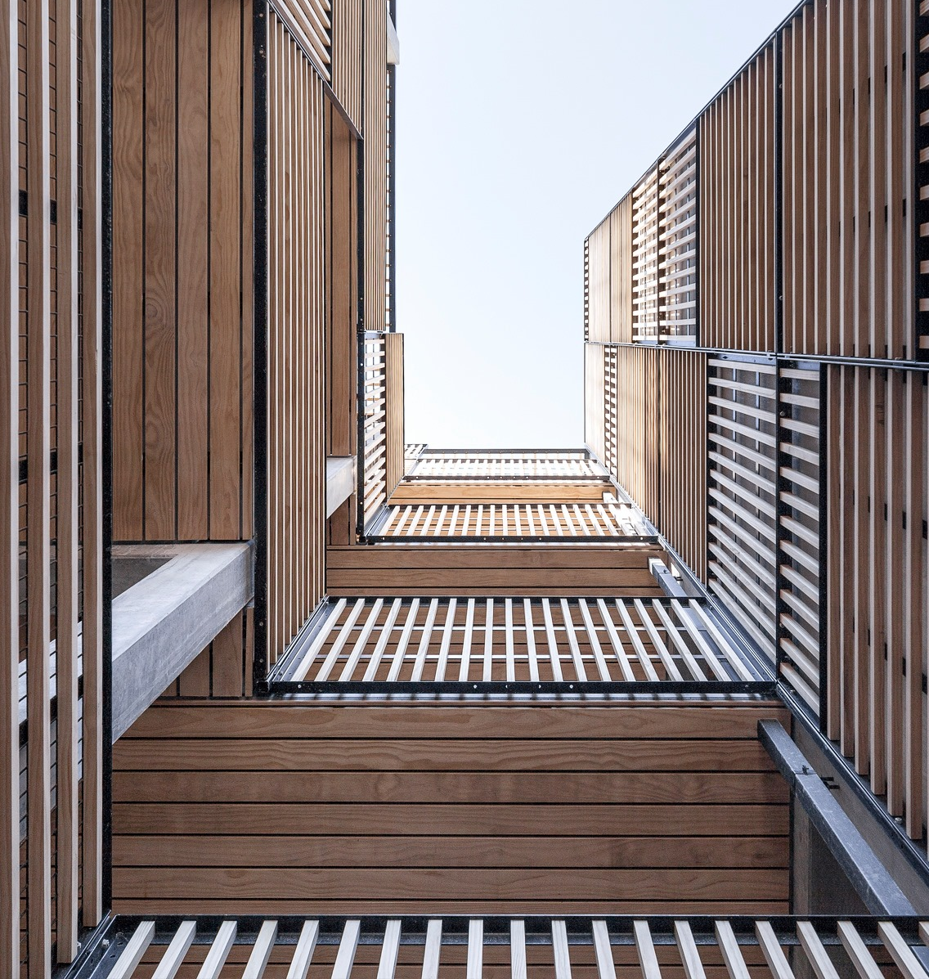
Intelligent Hotel Network System
COE444 Project: Final Report
Abstract:
The objective of our presentation is to exhibit our futuristic vision of IoT hotel using theoretical model.
Instructor:
Dr. Tarek Sheltami
Students:
Mohannad El-Kafrawi 201526270
Mohammed Al-Oraifi 201635180
Osama Bujwaied 201661700
Photography: Rozbeh Zavari

Slide 2
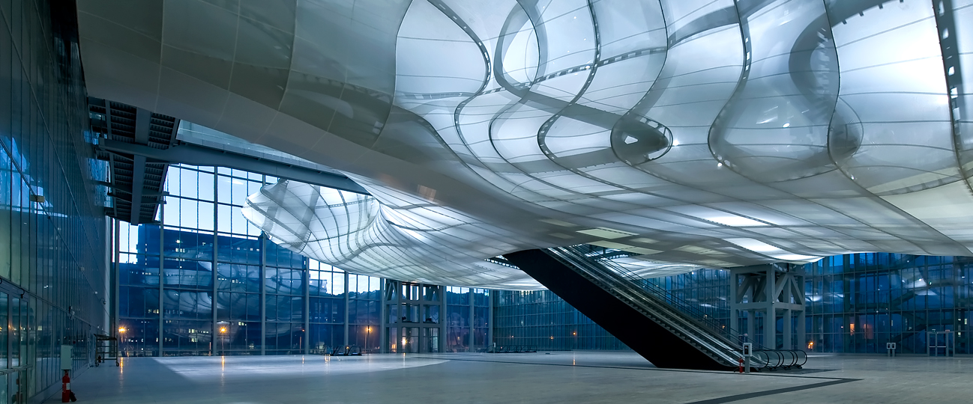
Overview
Introduction
Description of The Problem
Our Model: Layout
Our Model: Devices
Short Demo
Result Discussion
Conclusion
Congress Centre and Hotel in Rome
Notes:
For final:
Introduction
Our Model: Layout
Our Model: Devices (used)
Advantages: Efficiency (Cost is included)
Advantages: Convenience (Ease)
Advantages: Safety & Security
Demo
Issues and Solutions
Conclusion

Slide 3
Introduction
In this project, we model our futuristic vision for IoT hotels.
Our model is made to offer fabulous and practical experience to hotel visitors.
This should allow hotels to improve in the following categories:
Efficiency.
Convenience.
safety & security.

Slide 4

Description of The Problem
Problem with Traditional hotels:
Weak safety from fire.
Wasted storage of cameras record.
Difficult access to the room.
Wasting electricity

Slide 5
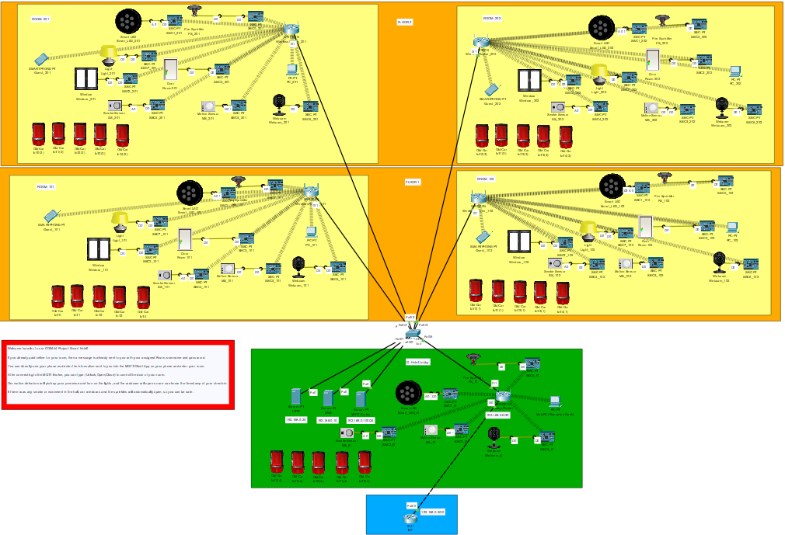
The Layout
Lobby is at G, which will have
3 servers (DNS, HTTP, MQTT Broker)
Lobby Wireless Router
IoT Devices connected to the router
Hotel Contain Several floors, and each floor contain many rooms.
Each room has a wireless router, and IoT Devices connected to the router.
This model should be scalable
Hotel Network Design

Slide 6
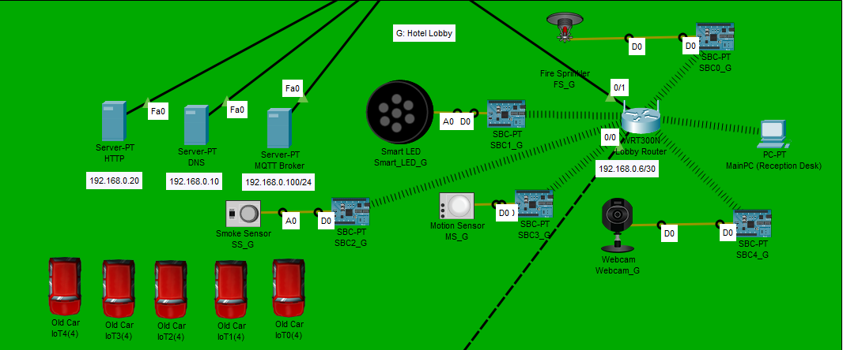
Lobby
Lobby is at G, which will have
Wireless router
DNS Server
HTTP Server
MQTT Broker
IoT Devices connected to the router through SBCs.
Lobby

Slide 7
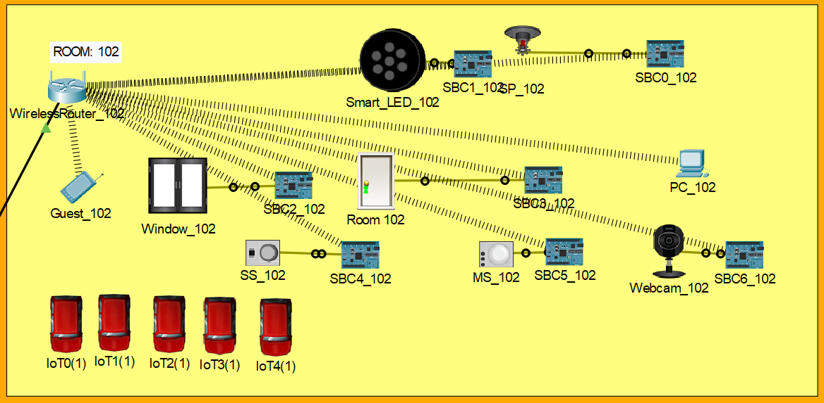
Rooms
Each Room specified with a range of IP addresses
Each rooms has several devices such as:
Door with lock/unlock feature
Smoke detector
Motion Detector
Smart LED
Web camera
Windows
Fire sprinkler
Guest Smartphone
Room

Slide 8

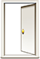
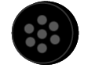





Devices
Any IoT device can be integrated in the model.
Every room devices are connected to the same switch
Devices chosen for efficiency, convenience, and safety.
Door
Smart LED
Window
Sprinklers
Smock Detector
Web Camera
Motion Detector
Smartphone

Slide 9

Short Demo
Triggering smoke detector to open doors and windows and start fire sprinkler

Slide 10

Result Discussion
Our hotel Model Provide
Higher safety from fire.
More efficient storage use of cameras record.
Easier and faster access to the room.
Reduce electric consumption
Simple and practical Devices Connection

Slide 11
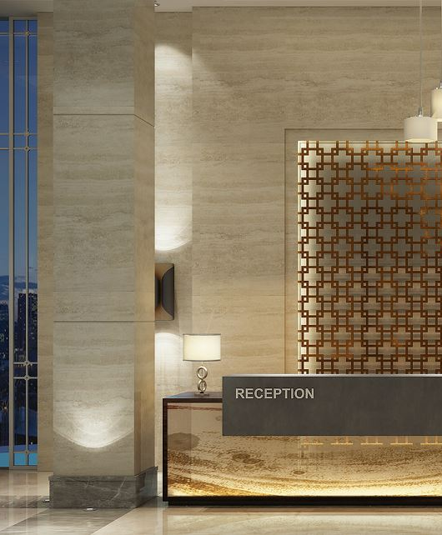
Conclusion
We believe our vision can help all parties involved in the hospitality system.
Hotel client will get more convincing and practical experience.
Hotel owner and employee will have easier control of the hotel infrastructure.

